Slide 1

Final Year Project Presentation
on Innovative Lab Prototype for Predicting Landslide Risks via Soil Moisture and Temperature Data
Department of ECE
National Institute of Technology Agartala

Slide 2
Acknowledgement
We would like to thank our supervisor, Dr. Mitra Barun Sarkar for being a great mentor and the best adviser we could ever have. His advice, encouragement and critics are source of innovative ideas, inspiration and causes behind the successful completion of this report. The confidence shown on us by him was the biggest source of inspiration for us. It has been a privilege working with him.
Group -11
Abhishek Debnath (21UEC007)
Santa Sarkar (21UEC016)

Slide 3
Objective
Innovative Lab Prototype for Predicting Landslide Risks via Soil Moisture and Temperature Data
Why It Is Needed:
Landslides cause severe destruction to life, property, and infrastructure.
Conventional monitoring systems are inefficient or lack real-time monitoring.
Helps in better prediction, prevention, and timely evacuation.

Slide 4
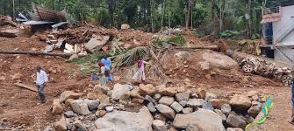
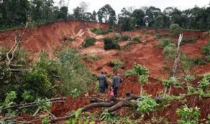
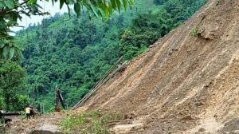
Historical Evidence of Landslides
Malpa Landslide (1998)
Kodagu Landslides (2018)
Darjeeling Landslides (2020)
Caused by excessive rainfall.
Over 250 people killed in Pithoragarh district, Uttarakhand.
Intense rainfall triggered massive landslides and floods.
Significant loss of life and property.
Continuous heavy rainfall led to landslides.
Disrupted transportation and damaged property.

Slide 5

Key Takeaways from History
Landslides are a serious threat to life, property, and infrastructure, especially in hilly and monsoon-prone regions.
Historical incidents highlight the need for better prediction systems to reduce damage and casualties
Heavy rainfall is a major cause of landslides, making rainfall monitoring crucial.
Historical incidents highlight the need for better prediction systems to reduce damage and casualties.
What are we Proposing?
A Innovative Lab Prototype for Predicting Landslide that Continuously measures rainfall and sends data to a cloud server.
Compares real-time data with pre-defined threshold levels.
Provides early warning alerts when critical rainfall levels are detected.
Helps predict landslides effectively and provides sufficient time for preventive measures.

Slide 6
Block Diagram of the system:
Sensing stage
Soil moisture and temperature sensors continuously measure the current soil conditions.
The Arduino microcontroller processes the sensor readings and transmits the collected data wirelessly using the LoRa transmitter module.
Transmitting Stage
The LoRa receiver module receives the transmitted sensor data and passes it to the ESP32 microcontroller.
Receiving stage
The ESP32 sends the processed sensor data to Google Sheets using automation tools. This enables real-time logging, storage, and visualization of landslide-related parameters in a structured spreadsheet format.
Data Acquisition

Slide 7



Components Used
Hardware Requirements
Arduino
Uno
Temperature
&
Humidity Sensor
(DHT-22)
Soil Moisture
Sensor
Esp 32
Software tools
Arduino IDE
For programming and uploading the program to the microcontroller

Slide 8
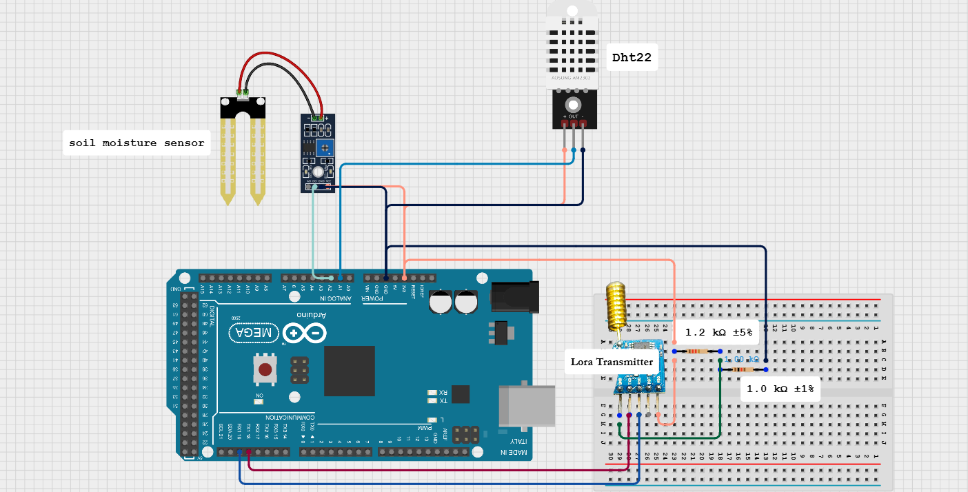
Circuit Diagram
Transmitter Section
Pin Connection
Component | Pin Name | Connected To (Arduino Mega Pin)
Soil Moisture Sensor | VCC | 5V
 | GND | GND
 | DO (Digital Out) | A1
DHT22 Sensor | VCC | 5V
 | GND | GND
 | DATA (OUT) | A2
LoRa Transmitter | VCC | 3.3V
 | GND | GND
 | RX | RX1
 | TX | TX1

Slide 9
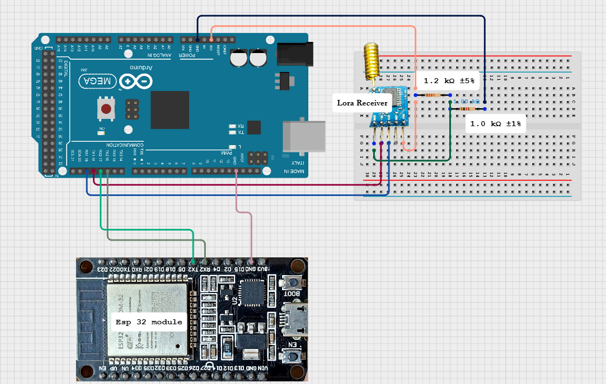
Circuit Diagram
Receiver Section
Pin Connection
Component | Pin Name | Connected To (Arduino Mega Pin)
Esp 32 module | Rx2 | Tx2
 | Tx2 | Rx2
 | GND | GND
LoRa Receiver | VCC | 3.3V
 | GND | GND
 | RX | RX1
 | TX | TX1

Slide 10
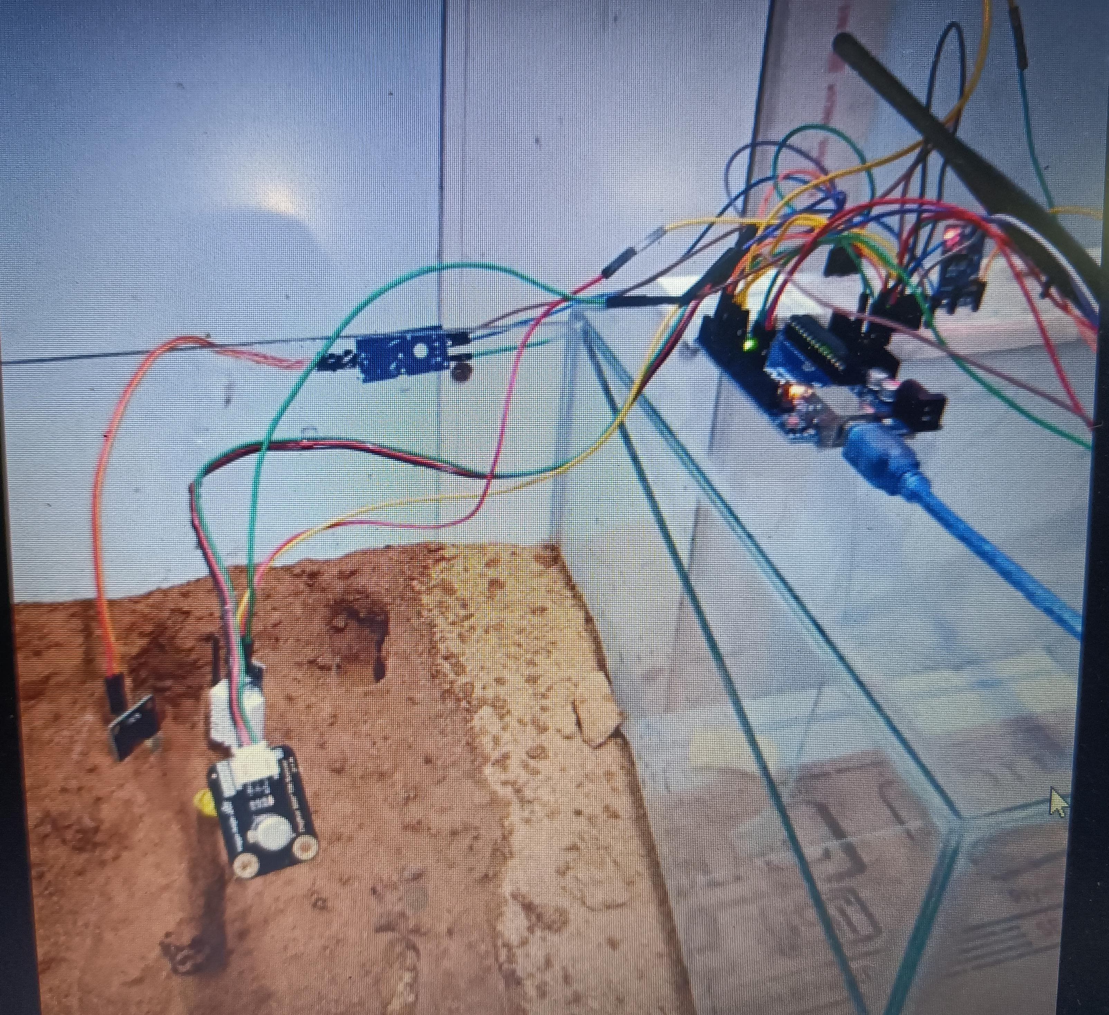
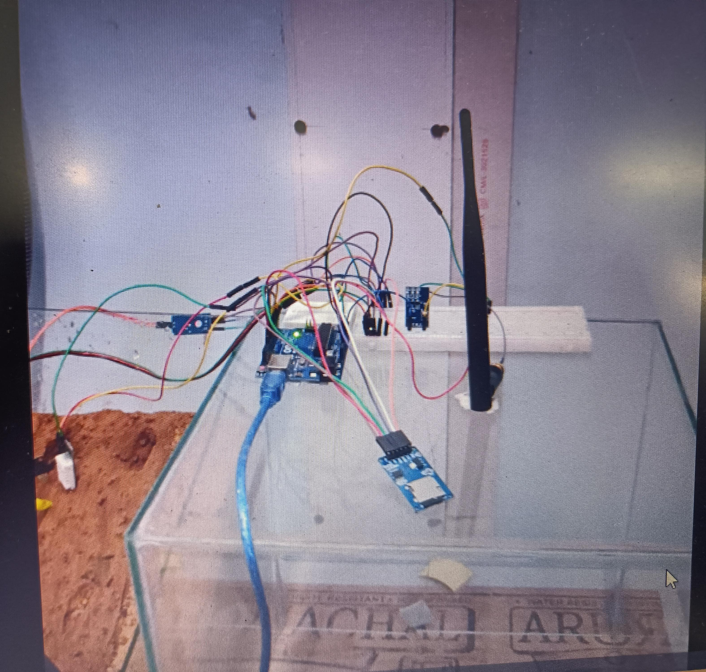
Practical Hardware Demonstration
Transmitter
Receiver

Slide 11
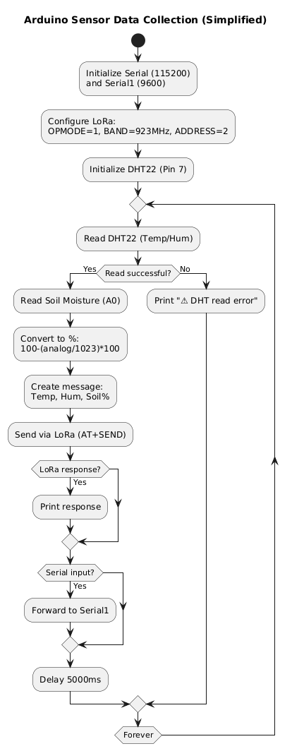
Lora Transmitter pseudocode
1. System Initialization
Serial Communication:
Serial (115200 baud) for debugging.
Serial1 (9600 baud) for LoRa module (TX1/RX1).
LoRa Configuration:
Sets OPMODE=1 (Transmitter), BAND=923MHz, and ADDRESS=2 (Sender Node).
Sensor Setup:
DHT22 (Pin 7) for temperature/humidity.
Soil Moisture (A0) for analog readings.
2. Main Workflow Loop
DHT22 Read Attempt:
✅ Success: Proceeds to soil moisture read.
❌ Failure: Prints error (⚠️ DHT read error) and skips to next cycle.
Soil Moisture Measurement:
Converts analog value (0–1023) to percentage (0–100%).
Data Packaging:
Creates a string with:
"Temp: XX.XX, Hum: XX.XX, Soil_%moist: XX.XX"
LoRa Transmission:
Sends via AT+SEND=1,length,message to Receiver (Address 1).
Response Handling:
Checks for LoRa ACK and prints if available.
Serial Passthrough:
Optional: Forwards serial input to LoRa module (debugging/commands).
Delay:
Pauses for 5 seconds before next cycle.

Slide 12
This code reads environmental parameters such as temperature, humidity, and soil moisture using the DHT22 and Soil Moisture sensors.
The sensor data is then formatted into a message string. Using LoRa communication, the data is transmitted wirelessly to a receiver node for monitoring or further processing.
We have also included serial monitoring for debugging and ensured the system checks for any sensor errors before sending.
The design is modular, scalable, and can be extended for real-time monitoring in smart agriculture or environmental studies.

Slide 13
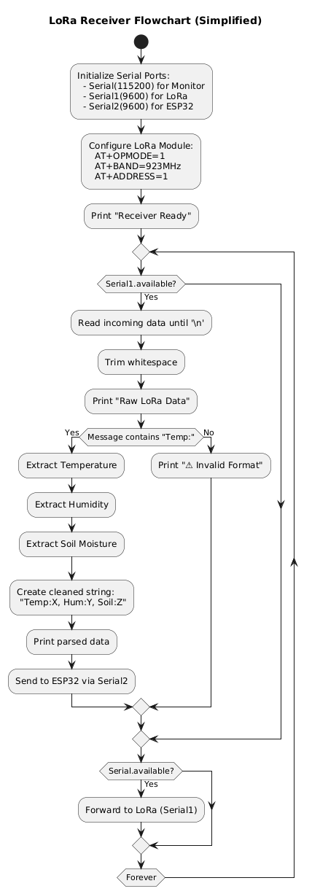
Lora Receiver pseudocode
1. System Initialization
Serial Communication:
Serial (115200 baud) for debugging/output.
Serial1 (9600 baud) for LoRa module (TX1/RX1).
Serial2 (9600 baud) for ESP32 communication (TX2/RX2).
LoRa Configuration:
Sets OPMODE=1 (Receiver Mode), BAND=923MHz, and ADDRESS=1 (Receiver Node).
Prints confirmation: "✅ LoRa Receiver Ready".
2. Main Workflow Loop
Data Reception:
Listens for incoming LoRa messages via Serial1.
✅ Valid Data:
Extracts: "Temp: XX.XX, Hum: XX.XX, Soil_%moist: XX.XX"
Prints parsed data to Serial monitor.
Forwards cleaned string to ESP32 via Serial2.
❌ Invalid Data:
Prints error: "⚠️ Parsing error: Some values missing."
Serial Passthrough:
Optional: Forwards Serial input to LoRa (Serial1) for debugging/commands

Slide 14
This code is designed to act as a receiver for sensor data transmitted over a LoRa communication network. It listens for incoming raw data from the LoRa module, processes and cleans the data to extract only the important sensor readings such as Temperature, Humidity, Soil Moisture,
Once the useful information is extracted and formatted properly, it forwards this cleaned data to another ESP32 device via a second serial port for further processing, display, or storage.
Additionally, this program establishes basic communication with the LoRa module during setup, allowing it to configure the module and ensure that it is ready to receive data.
It also supports a serial passthrough feature, which means any commands typed into the Serial Monitor can be sent directly to the LoRa module for testing and debugging purposes.

Slide 15
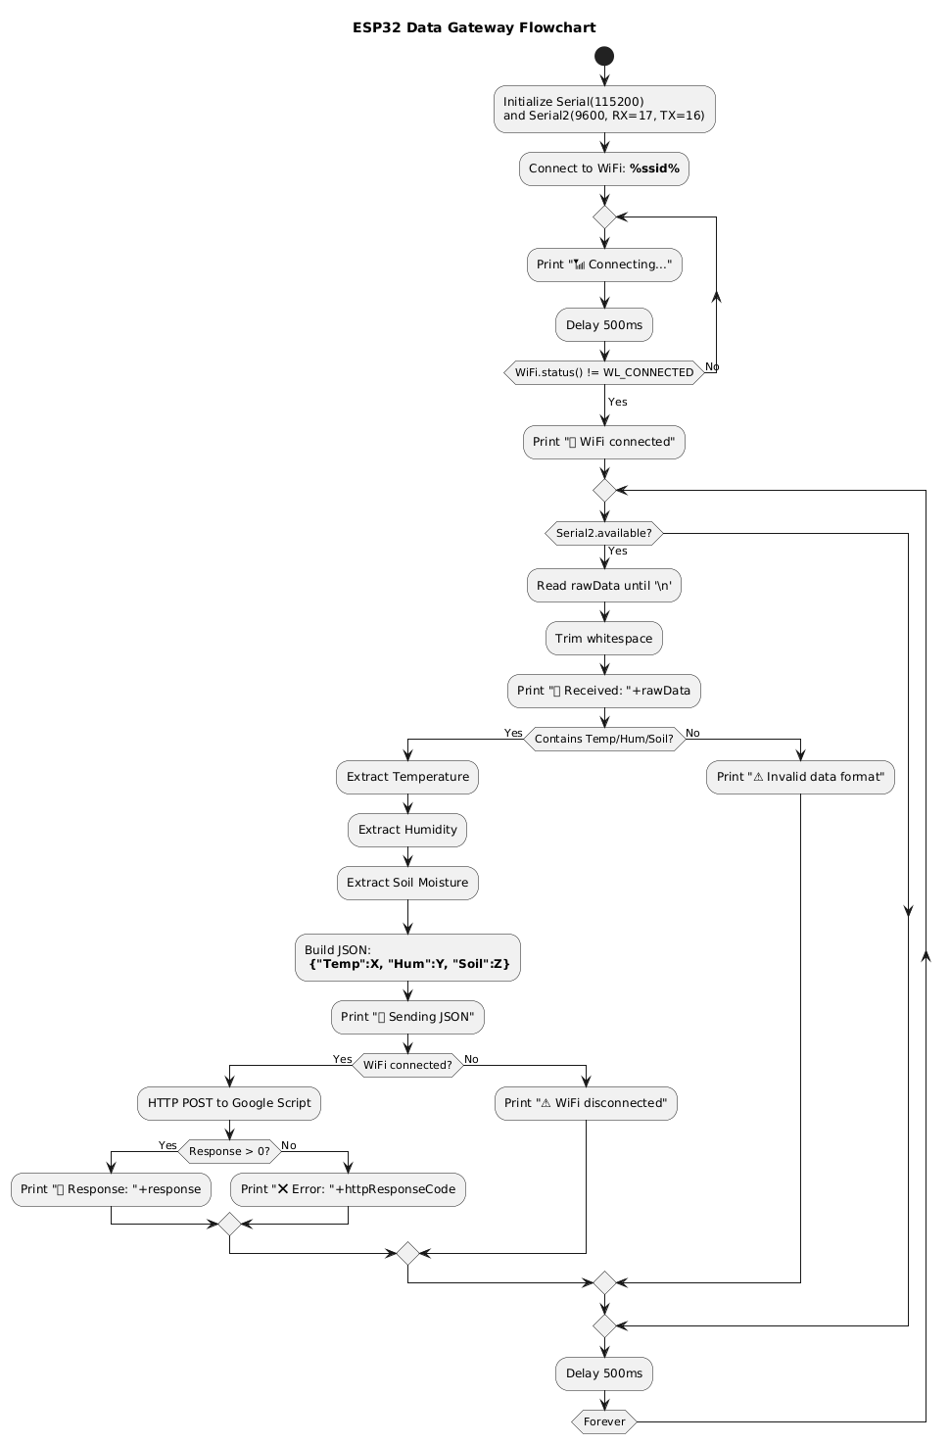
Esp32 pseudocode :
1. System Initialization
Serial Communication:
Serial (115200 baud) for debugging output.
Serial2 (9600 baud, RX=17/TX=16) for Arduino Mega UART.
WiFi Setup:
Connects to ssid with automatic retry.
Prints progress dots during connection (📶 Connecting...).
Confirmation: ✅ WiFi connected.
2. Main Workflow Loop
Data Reception:
Listens for Mega data via Serial2.
✅ Valid Data (contains Temp/Hum/Soil):
Extracts values:
Temp: XX.XX → "Temp":"XX.XX"
Hum: YY.YY → "Hum":"YY.YY"
Soil: ZZ.ZZ → "Soil":"ZZ.ZZ"
Builds JSON payload:
{"Temp":"XX.XX", "Hum":"YY.YY", "Soil":"ZZ.ZZ"}
Cloud Upload:
WiFi Connected:
HTTP POST to Google Script.
✅ Success: Prints server response.
❌ Failure: Logs HTTP error code.
WiFi Disconnected:
Prints ⚠️ WiFi not connected.
Error Handling:
Invalid data format: ⚠️ Data format invalid.
Timing:
500ms delay between cycles (prevents spamming).

Slide 16
This code allows an ESP32 to act as a smart gateway that receives cleaned sensor data (Temperature, Humidity, Soil Moisture) from another device over a serial connection.
It extracts and formats the data into a JSON structure, then uploads it live to Google Sheets using WiFi and an HTTP POST request.
During setup, it connects to a WiFi network and continuously listens for incoming data. If the data format is valid, it forwards it to a Google Apps Script endpoint; otherwise, it alerts about any formatting issues.
It also provides debugging information via the Serial Monitor, including connection status and server responses.
In short, this program bridges local sensor readings to online cloud storage for real-time remote monitoring.

Slide 17
Serial monitor Output
LoRa Transmitter
LoRa Receiver
🔧 Initializing LoRa Configuration...
Interface: AT
OK
OPMODE: AT+OPMODE=1
OK
BAND: AT+BAND=923000000
OK
ADDRESS: AT+ADDRESS=2
OK
✅ LoRa Node Configured
-------------------------------------------
🔌 Sensor Pins:
🌡️ DHT22 : Pin 7
🌱 Soil Moisture : Pin A0
-------------------------------------------
📤 Sending to LoRa Receiver:
Message: Temp: 25.50, Hum: 60.20, Soil_%moist: 45.30
Length : 45
-------------------------------------------
📨 LoRa Response:
AT+SEND=1,62, Temp: 25.50, Hum: 60.20, Soil_%moist: 45.30
OK
🔧 Configuring LoRa Receiver...
Interface: AT
OK
OPMODE: AT+OPMODE=1
OK
BAND: AT+BAND=923000000
OK
ADDRESS: AT+ADDRESS=1
OK
✅ LoRa Receiver Ready. Waiting for data...
📡 Raw LoRa Data: AT+SEND=1,62,Temp: 25.50, Hum: 60.20, Soil_%moist: 45.30
✅ Data Received:Temp: 25.50,Hum: 60.20,Soil: 45.30
Esp32 Output
🔧 Configuring LoRa Receiver...
Interface: AT
OK
OPMODE: AT+OPMODE=1
OK
BAND: AT+BAND=923000000
OK
ADDRESS: AT+ADDRESS=1
OK
✅ LoRa Receiver Ready. Waiting for data...
📡 Raw LoRa Data: AT+SEND=1,62,Temp: 25.50, Hum: 60.20, Soil_%moist: 45.30
✅ Data Received:Temp: 25.50,Hum: 60.20,Soil: 45.30
Data stored in
Google sheet/cloud

Slide 18
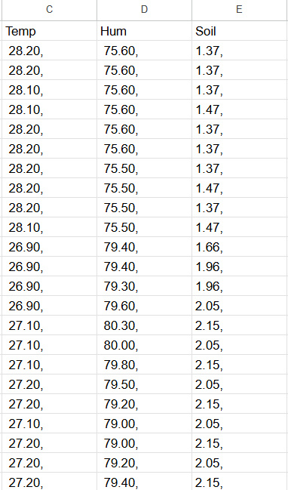

Sample Data Collected
in google sheet
https://tinyurl.com/2zy9562b

Slide 19
Technical Challenges :
Sensor Reliability & Environmental Noise:
Fluctuating readings due to weather changes and ground disturbances.
Sensor drift and false readings require regular calibration and sturdy hardware.
Data Transmission & LoRa Communication:
Signal loss in rugged terrains or dense forests.
Packet collisions or data loss from multiple nodes; requires optimized transmission and antenna placement.
Power & Hardware Limitations:
Limited power supply in remote areas and the need for weatherproof hardware.
Balancing durability, low power consumption, and cost-effectiveness for real-world deployment.

Slide 20
Limitations:
Geographical Coverage: Sensors cover small areas, requiring dense networks for wide deployment. Difficult and costly in rugged terrain.
Communication: LoRa has limited range and depends on stable internet. Signal loss and server issues can disrupt data transmission.
Sensor Noise: Environmental changes may cause inaccurate readings and false alarms, requiring better filtering.
Power Supply: Limited battery life and inconsistent solar power in remote areas; requires energy-efficient solutions for long-term operation.

Slide 21
Key Achievements
Multi-Sensor Data Acquisition: Integrates sensors for soil moisture, temperature, humidity, rainfall, to monitor landslide conditions.
2.LoRa and IoT Communication: Utilizes LoRa for long-range, low-power data transmission to cloud for remote monitoring.
4.Low-Cost, Scalable: Built with affordable components, making it scalable for large deployments in remote areas.

Slide 22
Future Improvements
Advanced ML Models: Use SVM, Random Forest, or neural nets for better accuracy and adaptability.
Mobile App Alerts: Send real-time alerts, show live sensor data, and allow users to report local events.
Government Portal Integration: Auto-share data with NDMA, IMD, and link with GIS maps for real-time monitoring.
Renewable Energy Use: Integrate solar, wind, or piezo-based power with smart energy management.
Drone Monitoring: Deploy drones for aerial scans and data collection in inaccessible terrains.

Slide 23
A Project Proposal On Understanding landslide kinematics using IoT and development of a site-specific landslide early warning system using AI/MLIn collaboration with Space Technology Incubation Centre, NIT - Agartala
Budget:
The total budget required for the project is Rs 19,97,000 (Rupees Nineteen lakhs ninety-seven thousand only) spared over three years. The budget break up is provided below:
S.N | Items | 1st Year | 2nd Year | 3rd year | Total
1. | Procurement of Equipment and all other accessories | 4,00,000 | 50,000 | 50,000 | 5,00,000
2. | Consumables | 40,000 | 40,000 | 40,000 | 1,20,000
3. | Contingency | 10,000 | 17,000 | 20,000 | 47,000
4. | Services (electrician cost, labor cost for fitting and installation, Technical Assistant/Manpower) | 2,90,000 | 2,90,000 | 3,00,000 | 8,80,000
5. | Characterization, Testing, sensor node, etc | 20,000 | 30,000 | 50,000 | 1,00,000
6. | Fabrication of sensor nodes | 50,000 | 80,000 | 70,000 | 2,00,000
7. | Travel | 30,000 | 50,000 | 70,000 | 1,50,000
 | Total | 8,40,000 | 5,57,000 | 6,00,000 | 19,97,000

Slide 24
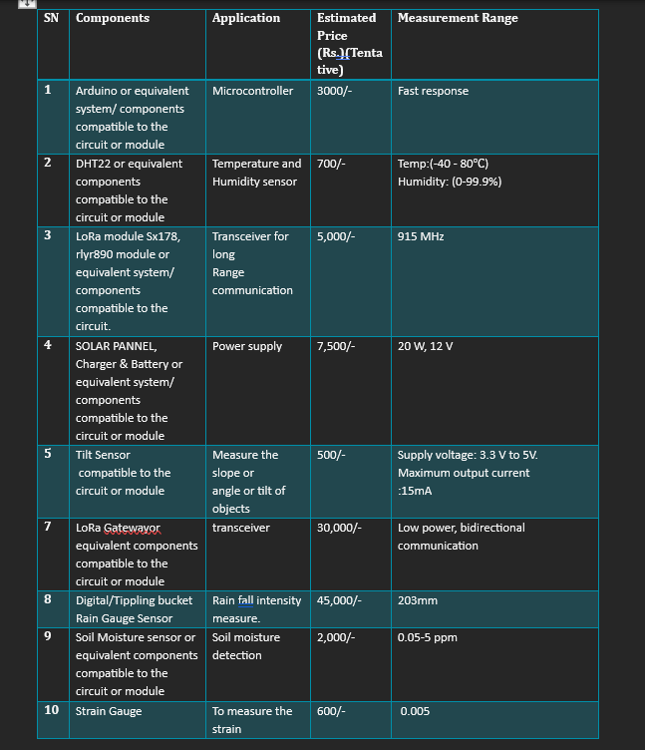

Slide 25
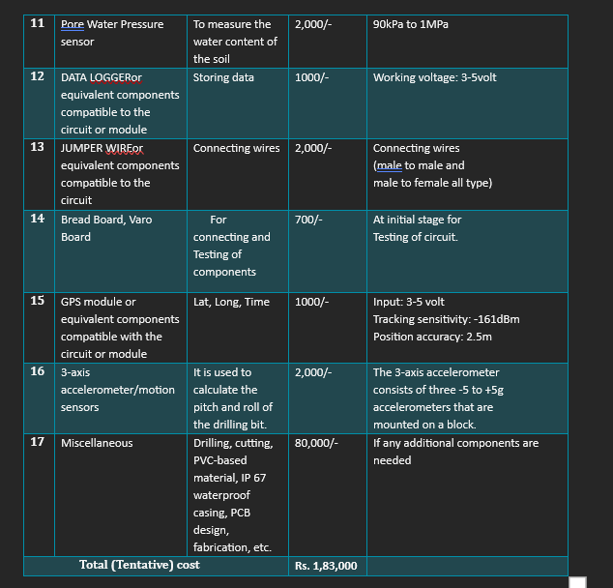

Slide 26
THANK YOU
Thank you

